Slide 1

Social Persona Mapping OSINT
Automated Multi-Account Detection & Network Analysis Using AI
Analyzing online behavior, presence, and interactions across digital platforms.

Slide 2


What is Social Persona Mapping?
A process of analyzing and visualizing online behavior, presence, and interactions. It's a critical tool for understanding digital identities.
Identify Multi-Accounts
Reveal Supporter Networks
OSINT & Cybersecurity
Pinpoint multiple online identities controlled by a single individual.
Uncover influence clusters and aligned communities.
Essential for investigations, digital forensics, and research.

Slide 3

Online Behavior
Online behavior encompasses the digital footprints an individual leaves through their actions.
Posting Dynamics
Frequency, timing, topics, hashtags, tone, and content preferences.
Stylometric Analysis
Unique writing style, vocabulary, and linguistic patterns.
Activity Rhythms
Consistent activity cycles and posting patterns.
Media Engagement
Types of media shared and their visual characteristics.

Slide 4

Online Presence
Online presence is the curated self-presentation across digital platforms, reflecting identity and branding.
Usernames and handle patterns
Consistency across accounts
Profile photos and bios
Visual or branding similarities
Platform activity history
Language and cultural markers

Slide 5
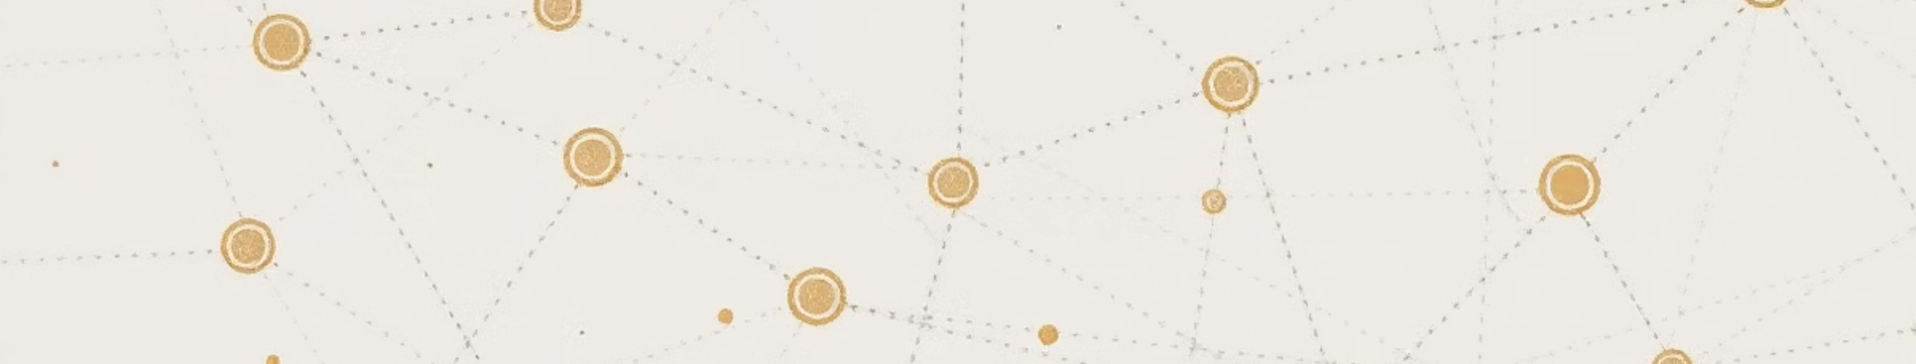
Online Interactions
Online interactions illustrate how an individual connects, influences, and is influenced by others in digital spaces.
Direct Engagement
Network Mentions
Likes, comments, replies, and shares.
Mentions and tagging behavior across platforms.
Follower Dynamics
Community Involvement
Who they follow and who follows them back.
Group or community participation and activity.

Slide 6

Why It Matters
Social Persona Mapping is crucial for navigating complex digital environments and enhancing security intelligence.
Detect Linked Accounts
Uncover covert multi-account operations.
Reveal Hidden Communities
Identify clandestine digital groups and networks.
Map Influence
Visualize coordination patterns and power dynamics.
Boost Threat Intelligence
Strengthen research and investigative capabilities.

Slide 7

Project Goals
Our mission is to empower professionals with advanced tools for digital identity analysis and network visualization.
Multi-Account Detection
Accurately identify accounts operated by the same individual with high confidence.
Supporter & Network Analysis
Efficiently find aligned accounts, clusters, and communities within complex datasets.
Persona Graph & Insights
Generate intuitive visualizations and extract actionable influence indicators.

Slide 8
System Overview
A streamlined, five-stage process from raw data to actionable intelligence.
01
02
03
Data Collection
Feature Extraction
Machine Learning Analysis
Gathering diverse online data points.
Identifying key attributes and behavioral markers.
Applying AI for pattern recognition and linkage.
04
05
Network Graph Generation
Dashboard & Reporting
Visualizing connections and relationships.
Presenting insights through interactive interfaces.

Slide 9

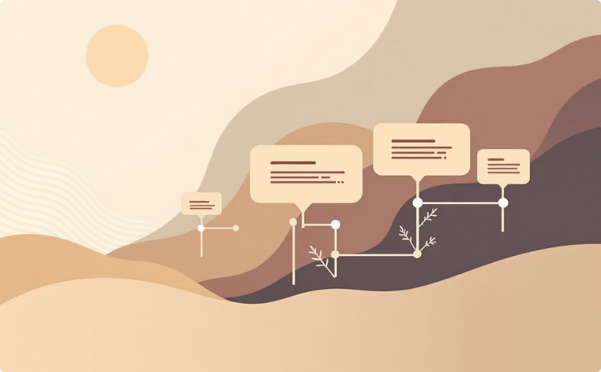

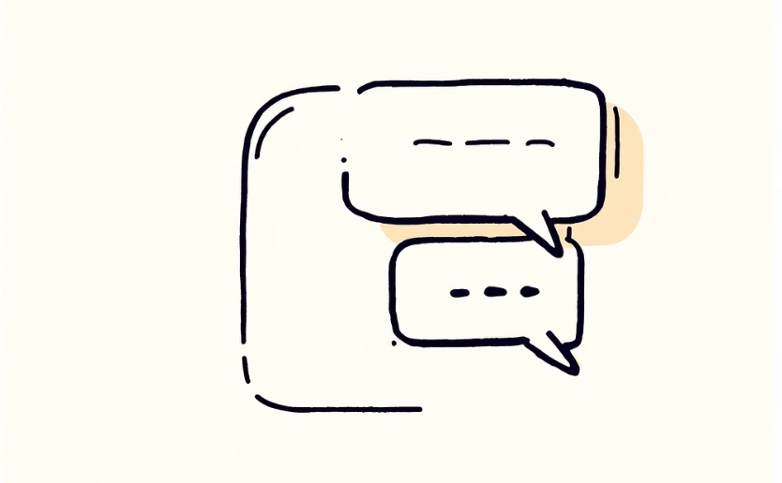
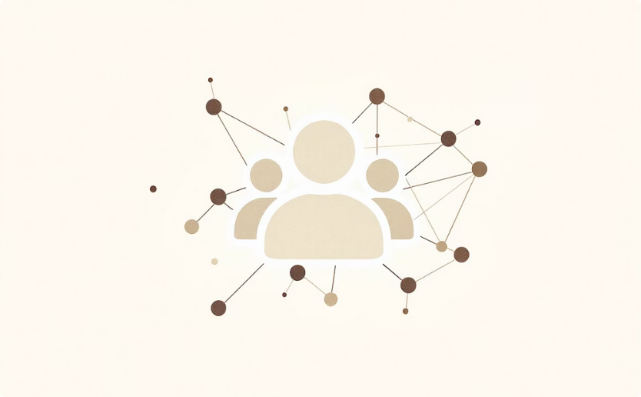
Data Collected
Our system ingests a comprehensive array of digital information for robust analysis.
Profile Data
Content History
Stylometry
Engagement
Usernames, bios, and profile images.
Posting history, timestamps, and hashtags.
Writing style and content patterns.
Likes, replies, and mentions.
Social Graph
Followers/following relationships.

Slide 10
Multi-Account Detection Engine
Our AI-powered engine leverages sophisticated algorithms to identify potential account linkages.
Username Similarity
Comparative analysis of account handles.
Profile Image Analysis
Detecting visual resemblances and patterns.
Writing Stylometry
Algorithmic comparison of linguistic traits.
Posting Time Patterns
Identifying consistent activity schedules.
Behavioral Footprints
Recognizing consistent user activity across platforms.
OUTPUT: Probability Score for Account Linkage

Slide 11
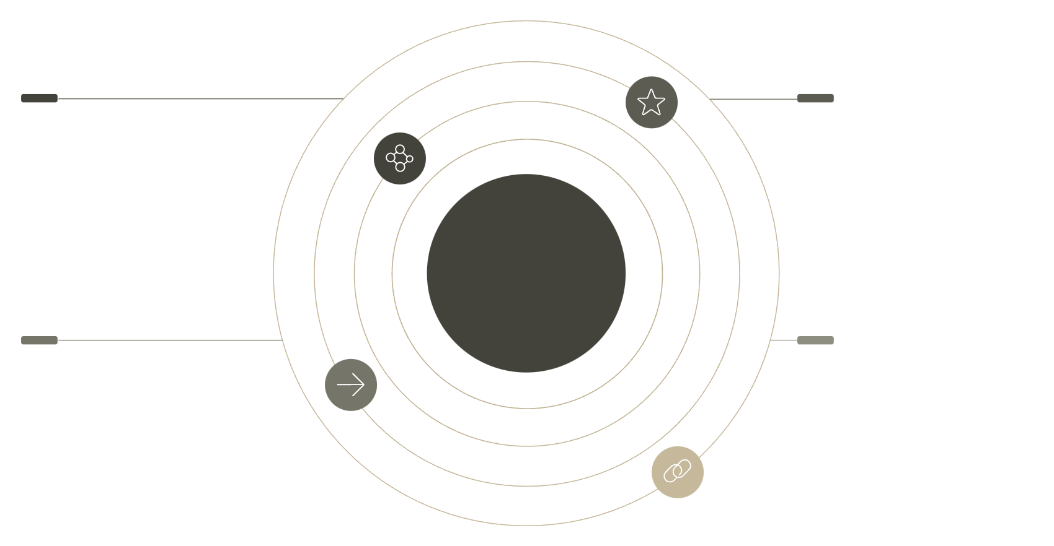
Network & Supporter Analysis
Our analysis moves beyond individual accounts to reveal the complex relationships and influence dynamics within digital ecosystems.
Identifies Frequent Interactors
Pinpoint the most active and consistent participants in discussions.
Clusters
Key Influencers
Distinct node groups representing communities
Larger nodes marking highest reach accounts
Detects Interaction Clusters
Group accounts into communities based on their engagement patterns.
Network & Supporter Analysis
Reveals Key Influencers
Information Flow
Edge Strength
Arrows showing direction of message spread
Weighted links indicating interaction frequency
Highlight individuals with significant reach and impact on conversations.
Maps How Information Spreads
Visualize the diffusion of content, ideas, and narratives across the network.
Organizes Accounts into Logical Communities
Segment the digital landscape into meaningful and actionable groups.

Slide 12
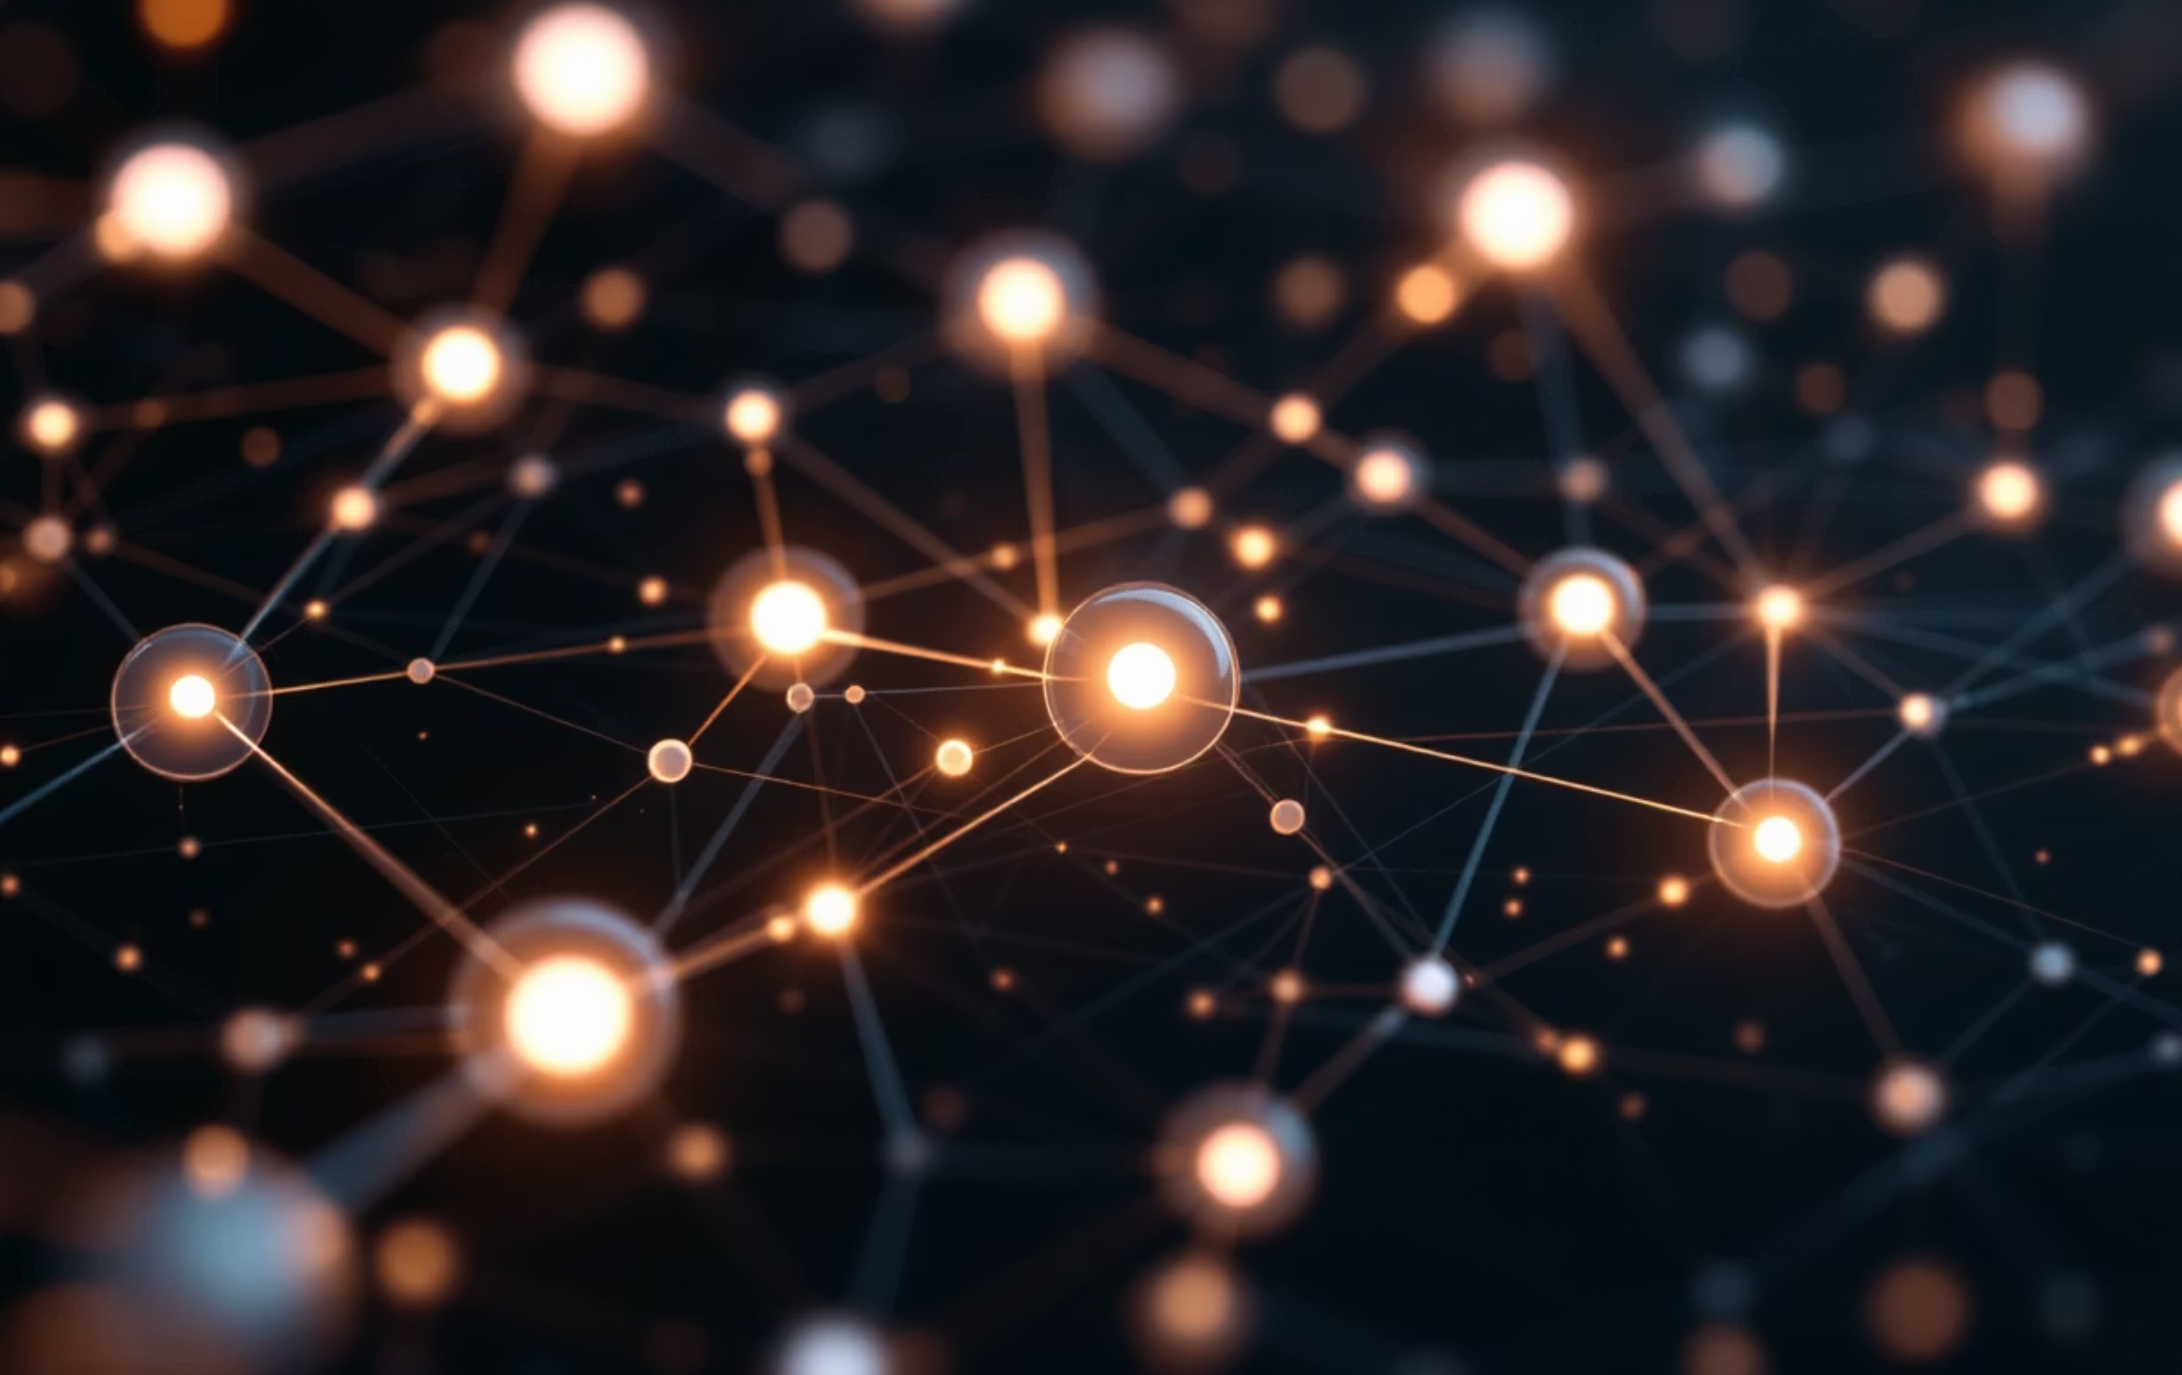

Persona Graph Visualization
The system generates an interactive, dynamic graph that brings complex digital identities and relationships to life.
Potential Multi-Accounts
Supporters / High-Interaction
Linked profiles likely tied to the target
Accounts with frequent engagements
Target Account Network
Clusters & Subgroups
Influence & Centrality
Color-coded communities and segments
Node size and link thickness metrics

Slide 13

System Architecture
Our modular system processes raw data through several stages to deliver actionable insights.
Data Collector
Feature Extractor
ML Analysis Engine
Gathers diverse online data from various sources.
Extracts key attributes and behavioral markers from raw data.
Applies advanced AI algorithms for pattern recognition and linkage detection.
Graph Analyzer
Database
Dashboard UI
Constructs and analyzes relationship graphs between identified entities.
Securely stores all processed data and analytical results.
Provides interactive visualizations and reporting for user analysis.

Slide 14
Final Output
Our system delivers comprehensive outputs tailored for in-depth analysis and strategic decision-making.
Multi-Account Probabilities
Network & Cluster Graphs
Detailed list of probable account linkages with confidence scores, highlighting potential covert operations.
Interactive visualizations of complex account relationships and emergent community structures.
Influence Metrics
Behavioral Insights
Quantifiable data on account influence, reach, and centrality within identified networks.
Summarized patterns of activity, posting habits, and interaction styles for each persona.
PDF/HTML Reports
Dashboard Visualizations
Exportable, comprehensive reports for offline review, stakeholder sharing, and archival.
Dynamic and interactive dashboards for real-time monitoring, data exploration, and trend analysis.

